Slide 1
UNIT 11
Race, Sex, and Family in WWII and postwar U.S.

Slide 2
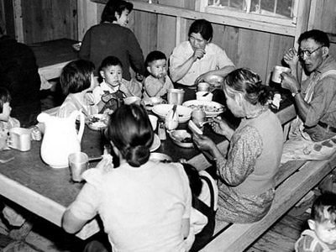
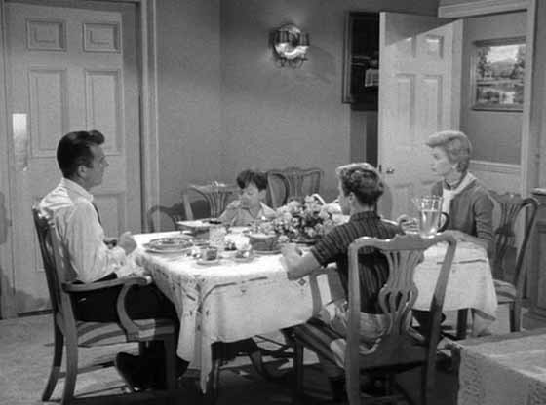
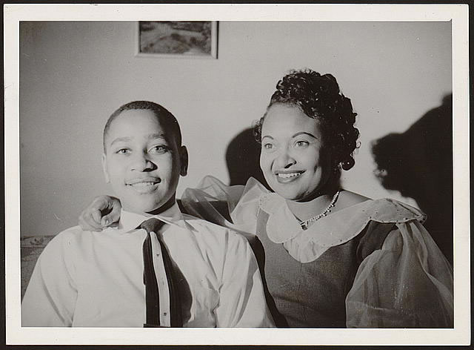
Families

Slide 3
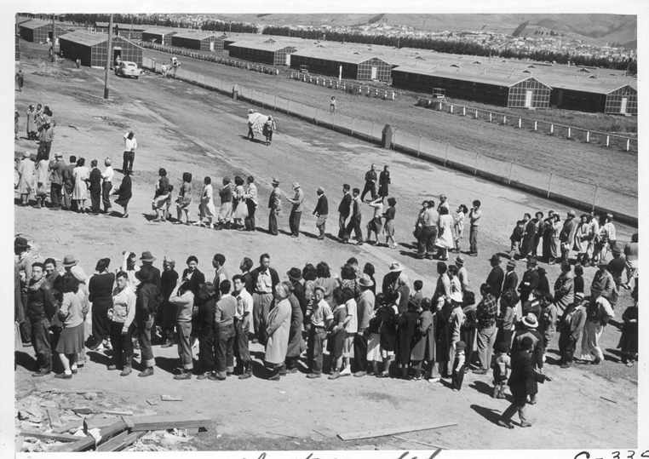
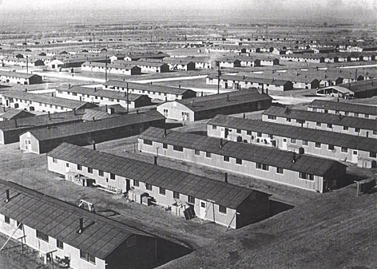
Japanese Internment 1942-1946

Slide 4
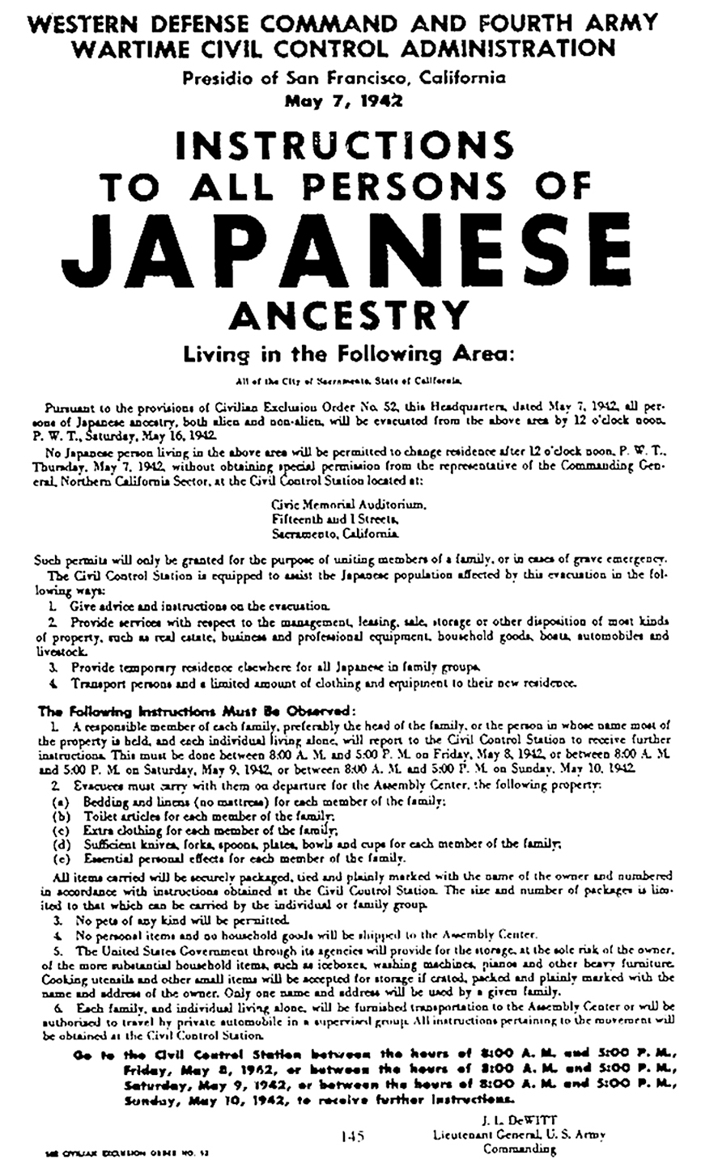
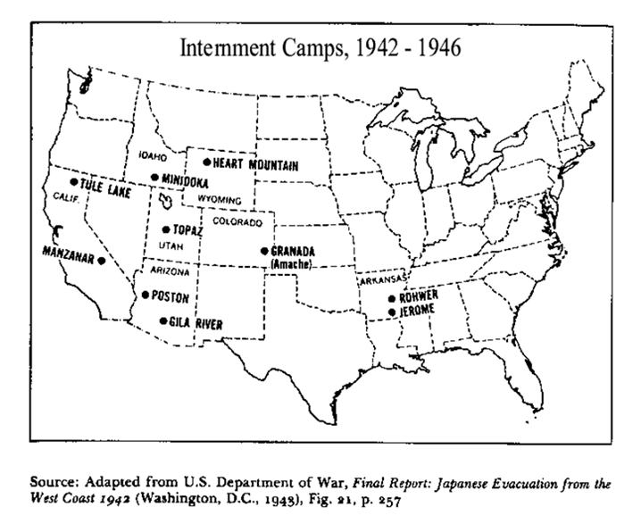

Slide 5
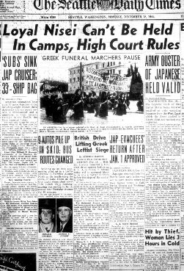
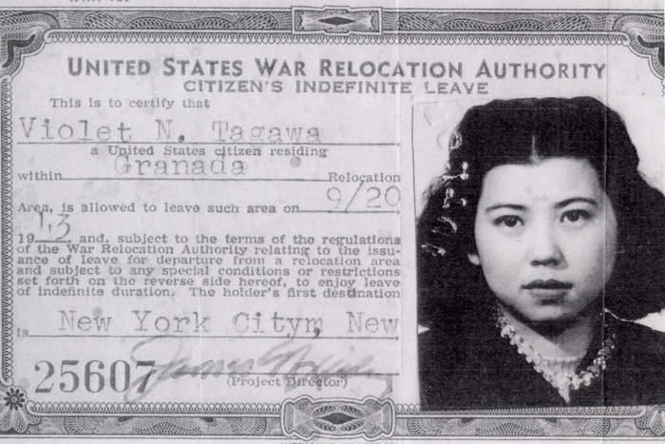
After the Internment Camps

Slide 6
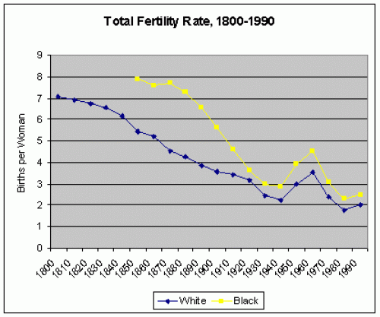
Decline in family size 1800-present
“Baby Boom,” 1940-1965

Slide 7
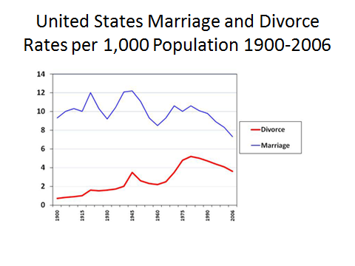
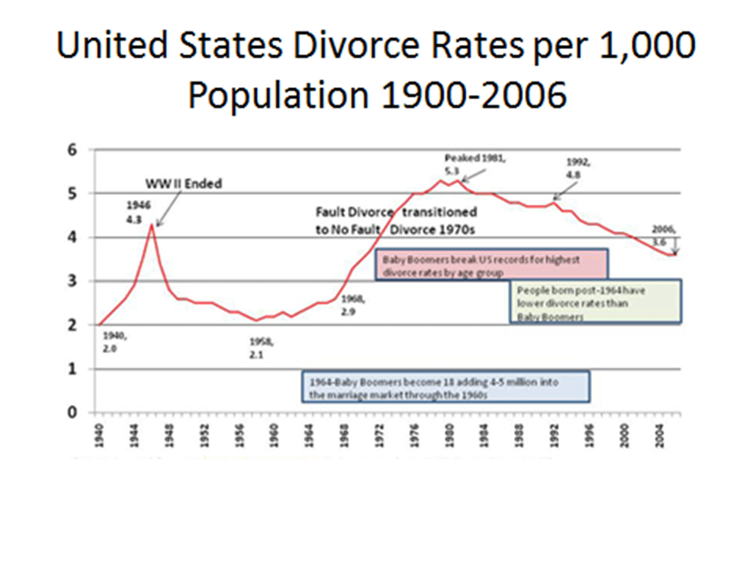
Marriage/Divorce rates 1900-present

Slide 8
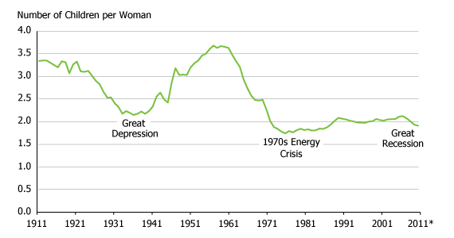
Births and the economy

Slide 9
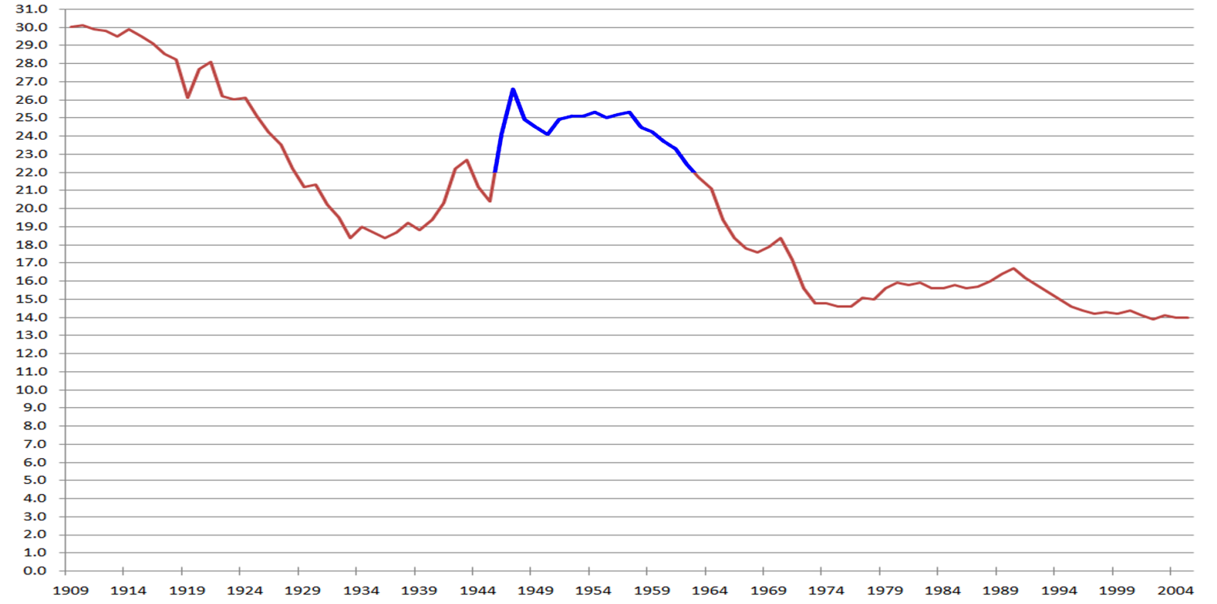
Baby Boom birth rate (numbers of live births per thousand of population)

Slide 10
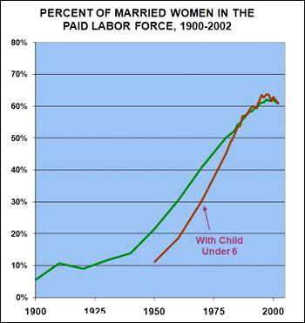
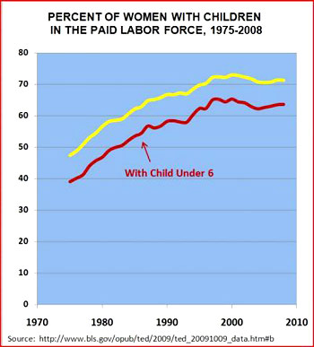
Married women in the work force

Slide 11
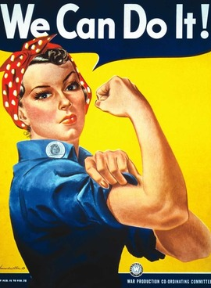
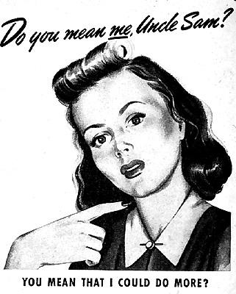
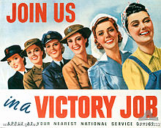
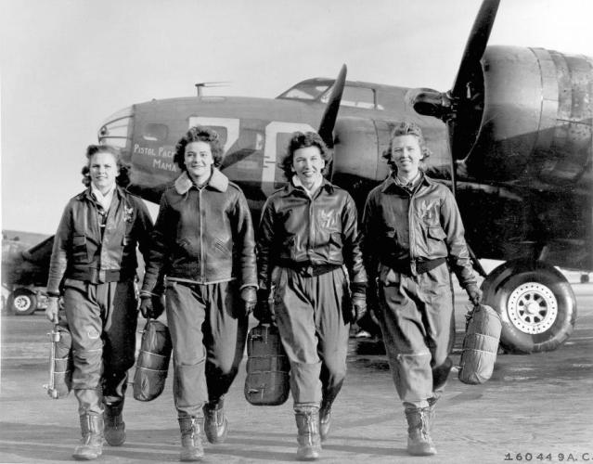
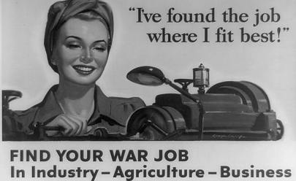
WWII-turning point for married women’s employment

Slide 12
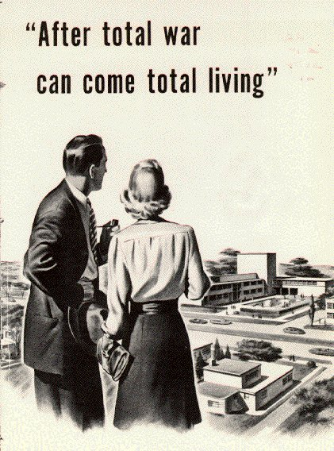
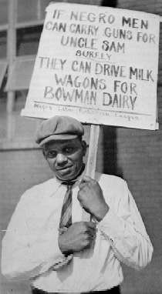
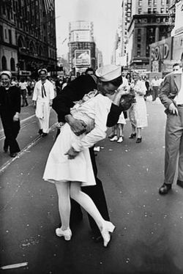
Making room for white veterans

Slide 13
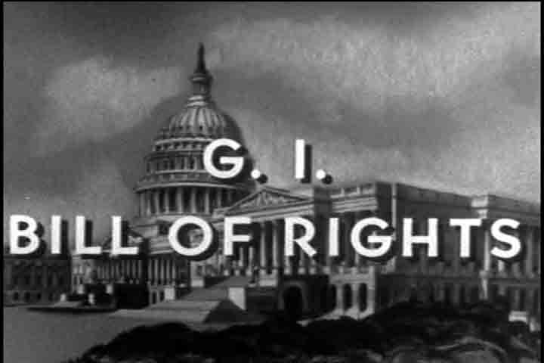
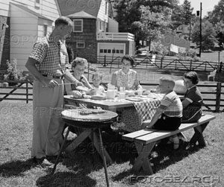
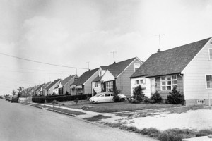
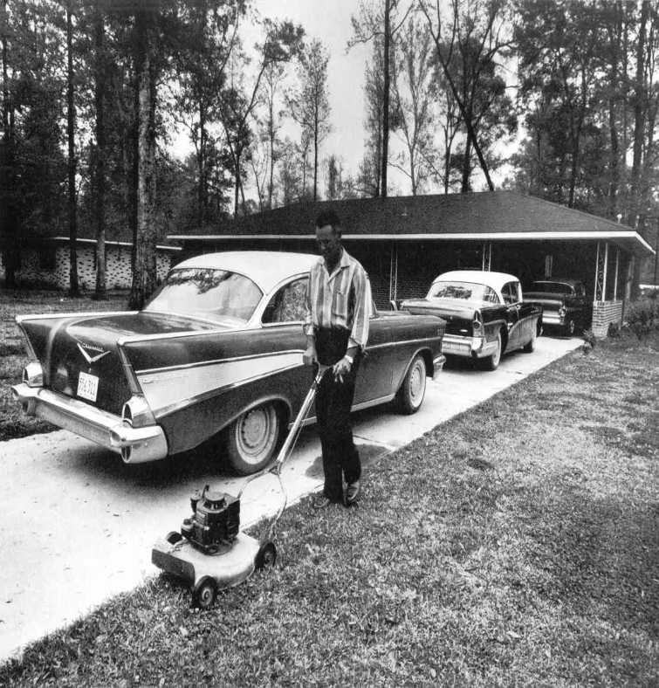
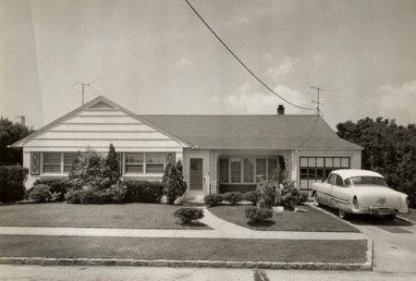
G.I. bill

Slide 14
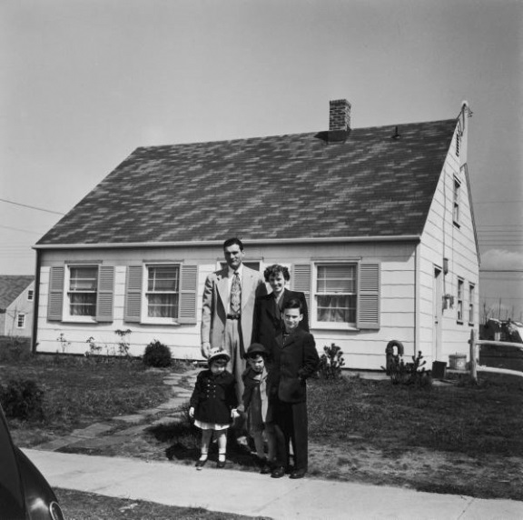
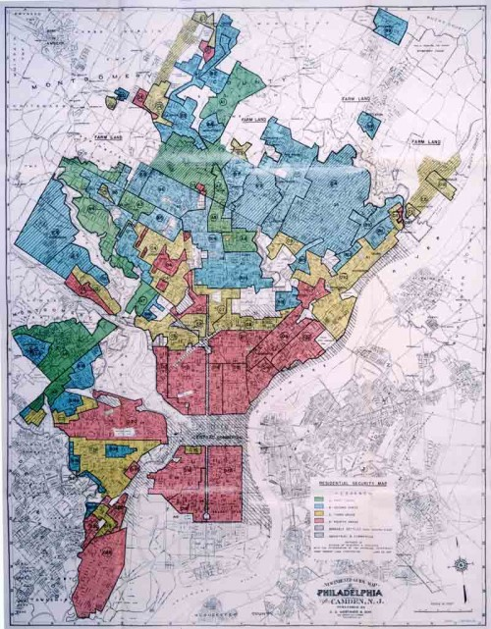
Racial segregation in housing
1934 Residential Security maps mark African American, Jewish, and other ethnic neighborhoods as too risky for bank investment
GI Bill of rights offers returning veterans favorable mortgage loans
Realtor practices of “steering” African Americans away from white suburban neighborhoods
White neighborhoods oppose integration

Slide 15
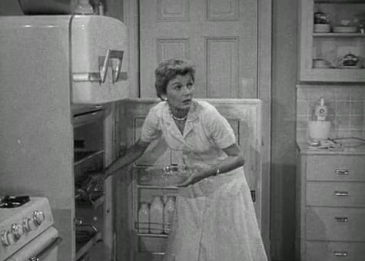
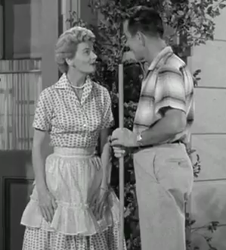
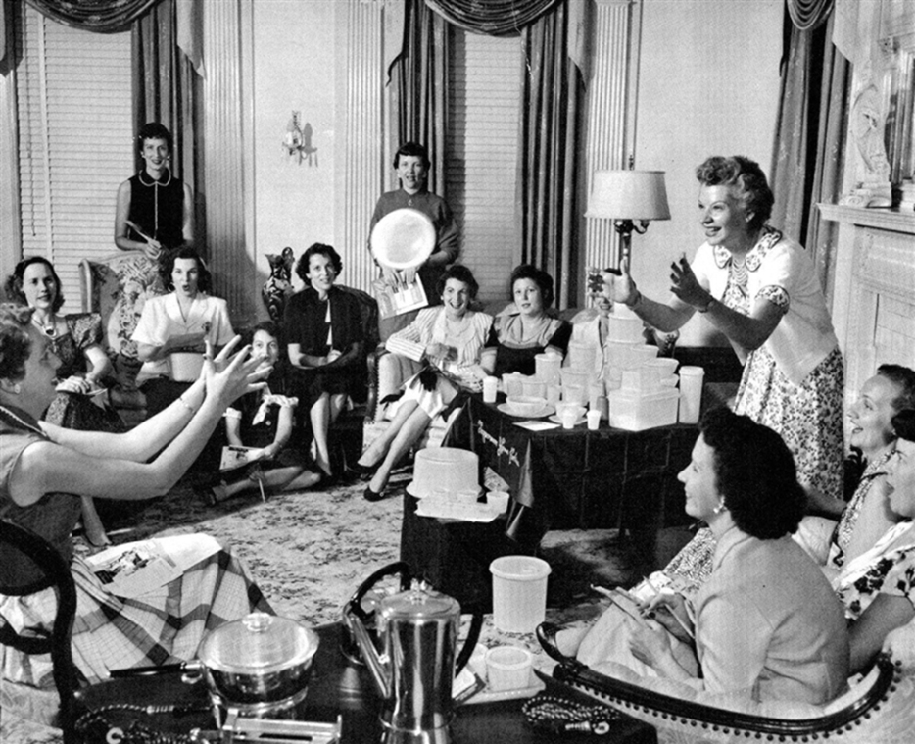
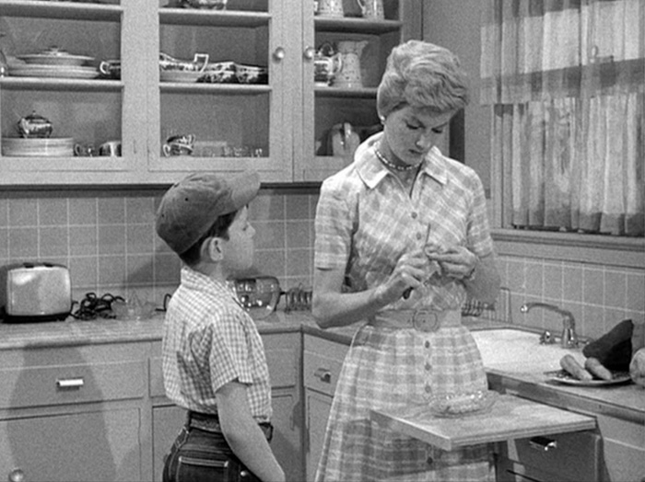
White middle class suburban consumerism

Slide 16
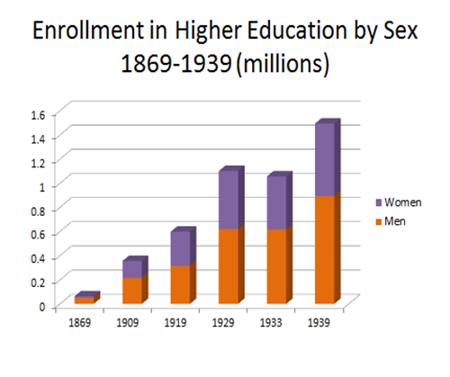
Enrollment in Higher Education by Sex 1869-1939 (in millions)
Near parity 1920
1920 – 315,000 men and 283,000 women

Slide 17
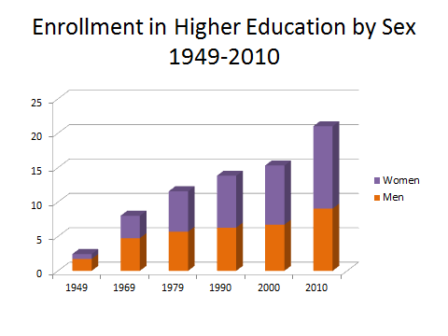
Enrollments in Higher Education by Sex 1949-2010 (in millions)
Parity reached only in 1978
1978 – 5,641,000 men & 5,619,000 women

Slide 18
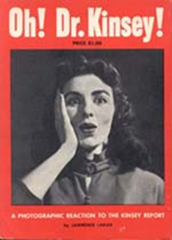
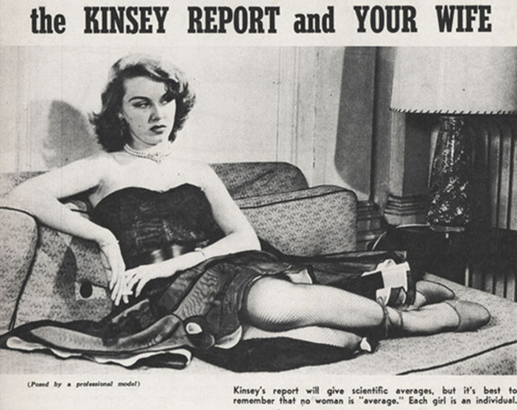
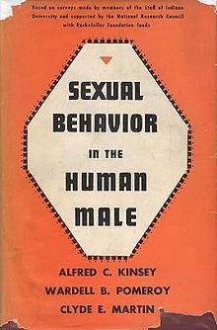
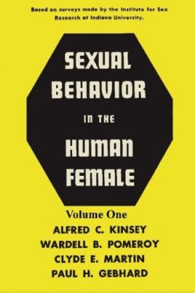
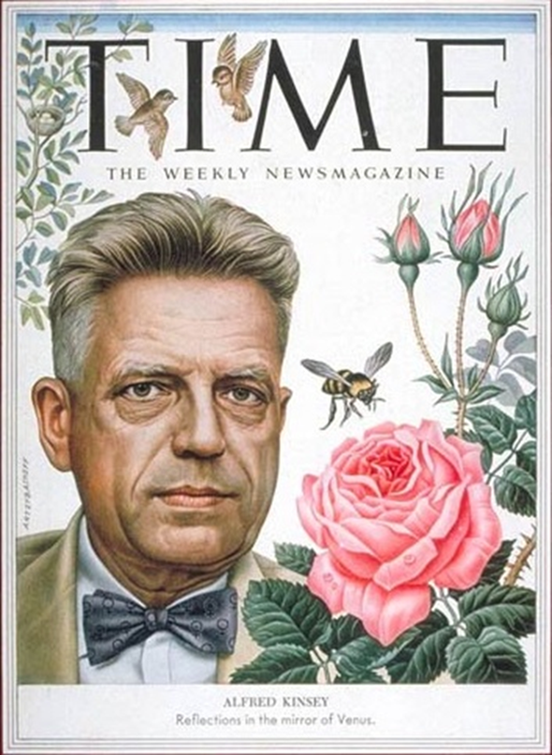
The Kinsey Reports
1948, 1953
1953

Slide 19
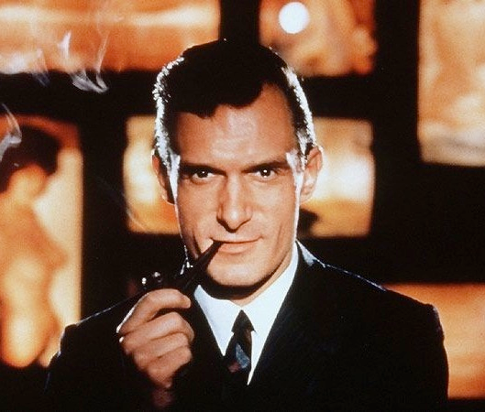

1950s rebellion: Hugh Hefner, Playboy Industries
First issue 1953
Pleasure of single heterosexual
male consumer

Slide 20

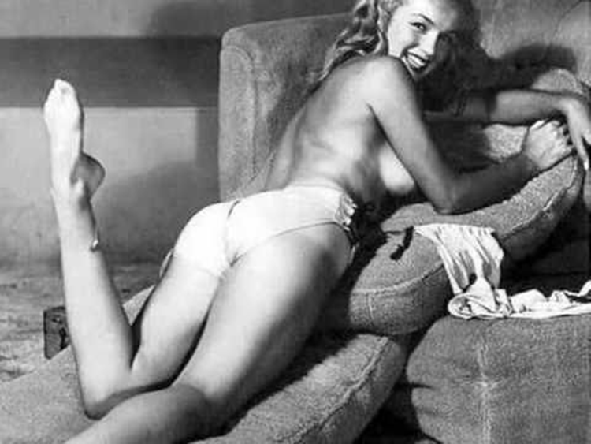
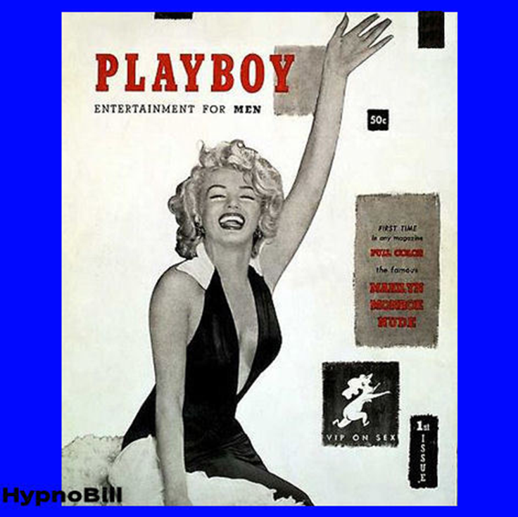
Playboy’s debut 1953

Slide 21
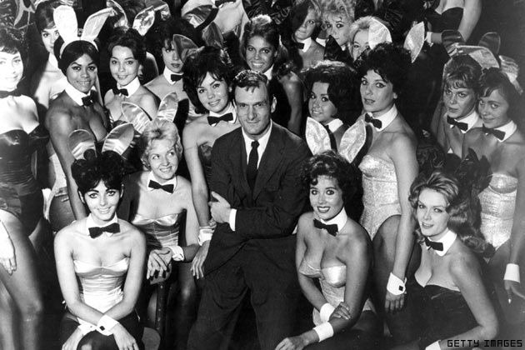
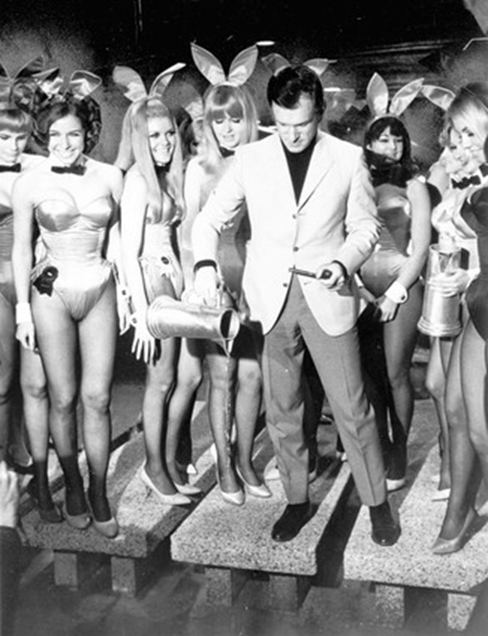
Hefner’s fantasy world

Slide 22
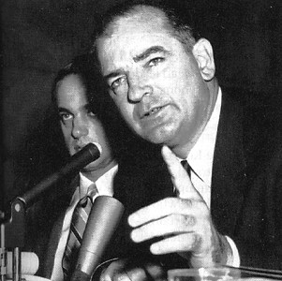
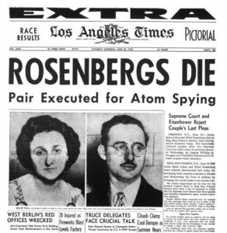
Red Scare: McCarthy hearings 1954
House Un-American Activities Committee (HUAC) 1938-1969
Hollywood blacklists
Senate trials
Government loyalty reviews
J. Edgar Hoover and FBI
Targeting of homosexuals in government
Ethel and Julius Rosenberg executed 1953 for passing atomic secrets to Soviet Union

Slide 23
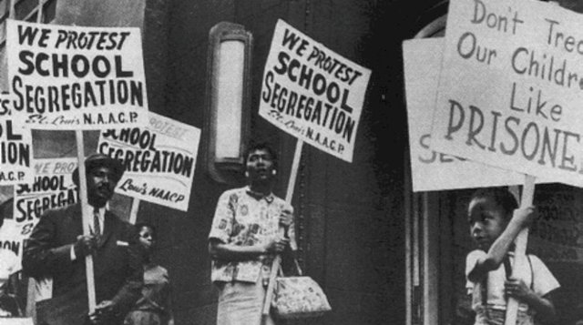



Brown v. Board of Education, 1954
Five separate suits joined under Brown
Rolls back Plessy v. Ferguson “Separate but Equal”

Slide 24

Murder of Emmett Till, 1955
Till, aged 14 and a native of Chicago, is murdered in Mississippi while visiting relatives. He allegedly flirted with a married white woman in a shop.
Till’s mother decides to leave his casket open so that the world can witness the brutality of his death.
Future African American activists and artists recall this shocking moment as life changing.

Slide 25


Montgomery Bus Boycott, 1955-56
Rosa Parks
Carpooling

